Slide 1
CS132 Group 14
Project 2
Huarong Path Game
Requirement 王 祎
Development 陈 放
Validation 张 斯 涵

Slide 2
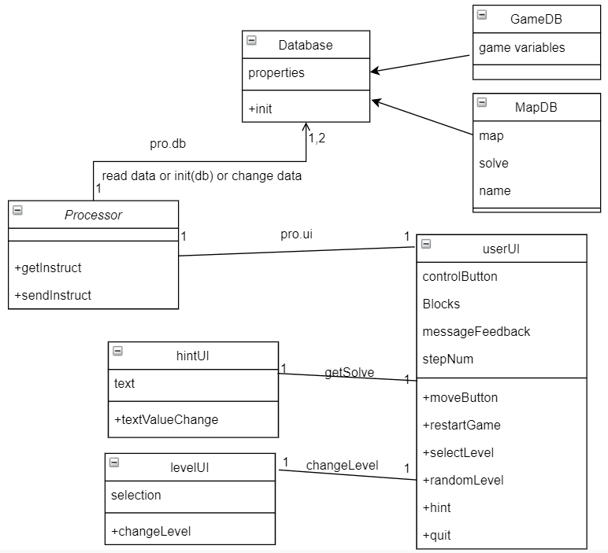
Class Diagram System Architechture

Slide 3
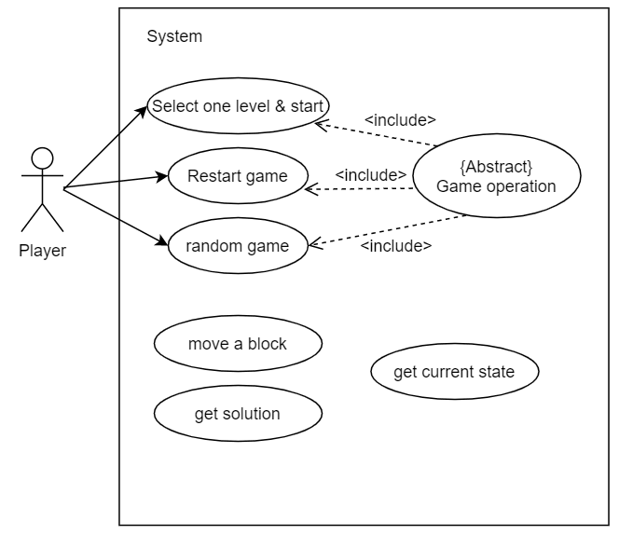
User Cases

Slide 4
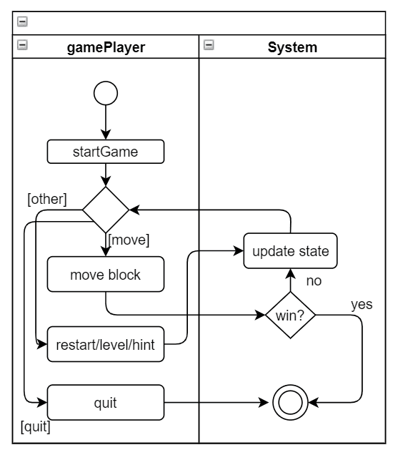
Activity Diagram

Slide 5
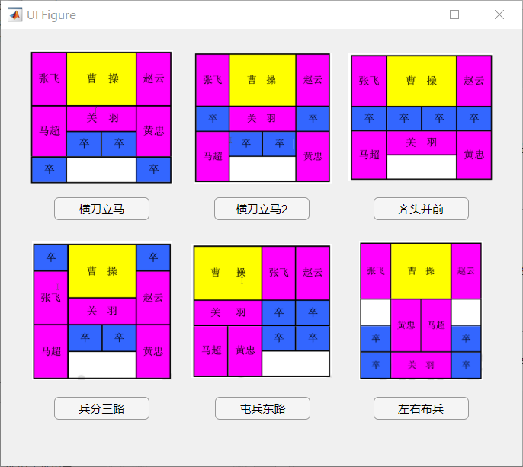
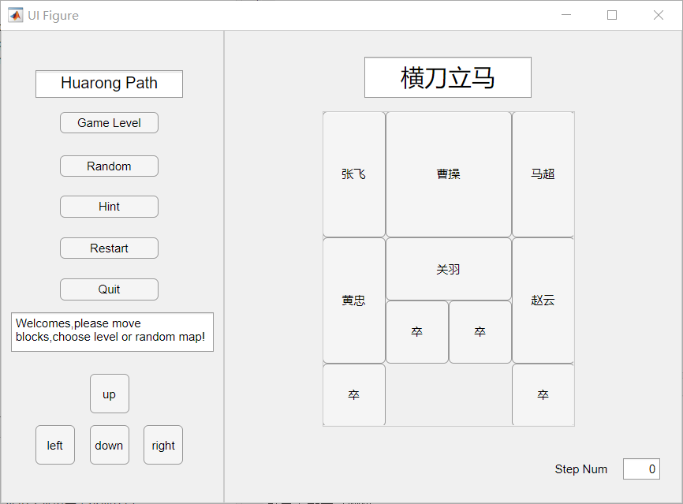
User Interface

Slide 6
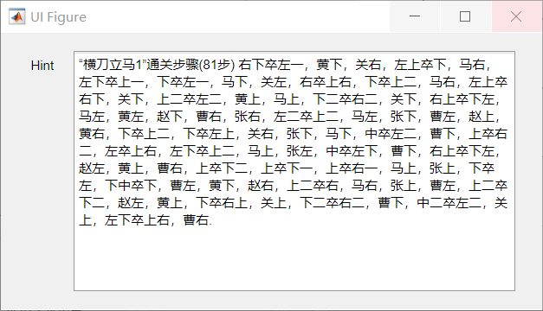
User Interface

Slide 7
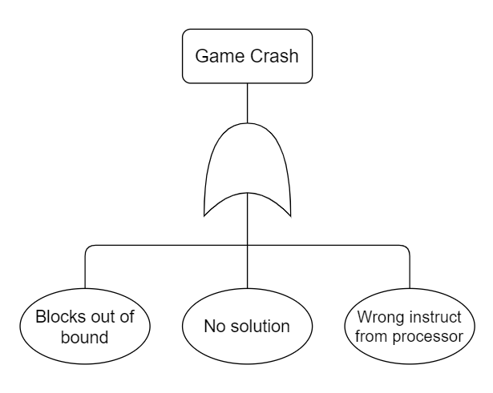
Fault Tree Analysis

Slide 8
Test Cases

Slide 9
Uppaal
E<> game.Victory%Game has at least one solution.
A[] forall block.inBound%every chess must be always in bound.
......

